Slide 1
Personal Computer Applications
HNDIT1101
(MS Access)
Lecture 10

Slide 2
What is Microsoft Access?
Microsoft Access is a relational database management system (RDBMS).
It is a software “engine” that provides an interface between physical data and user application queries.
Other examples of DBMS applications include:
Oracle
mySQL
SQL Server (Microsoft)
DB2 (IBM)
Informix

Slide 3
Why choose MS-Access over SPSS / Excel?
MS Access is best used for long-term data storage and/or data sharing.
MS Excel is best used for minor data collection, manipulation, and especially visualization.
SPSS is best used for minor data collection and especially data analysis.

Slide 4
Why choose MS-Access over other DBMS systems?
Cheap and available
Easy to use (no use of database server management)
Includes front-end tools for rapid application development (RAD)
MS-Access can handle a large number of records.
Multiple users may use the database simultaneously.

Slide 5
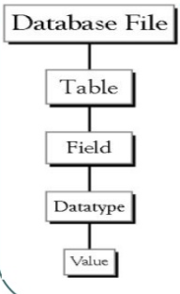
Database file
  This is the main file that encompasses the entire database.
Table
  A table is a collection of data about specific topic.
Field
  Fields are the different categories within a Table. Tables usually contain multiple fields.
Data types:
  Data types are the properties of each field. A field only has 1 data type.

Slide 6
Object types of MS Access.
An Access database contains six types of objects.
  Tables – A table is a collection of data about a specific topic.
  Queries – Queries are used to view, change and analyze data in different ways.
  Forms – Forms enables you to display and enter data in a convenient format.
  Report – A report is an effective way to present your data in a printed format.
  Macro – A macro is a set of instructions that automates a task you need to do often.
  Modules – In the rare cases where programming is necessary, you can write modules.

Slide 7

Data Types of Microsoft Access
1.Text :This field stores text and numbers and any combination of characters. It can contain up to 255 characters.
The FieldSize property controls the maximum number of characters that can be entered.
Name :Text(25)

Slide 8
2. Memo
  Use for lengthy text and numbers, such as notes or descriptions.
  Stores up to 65,536 characters.
3. Number
  Use for data to be included in mathematical calculations, except calculations involving money (use Currency type).
  Stores 1, 2, 4, or 8 bytes; stores 16 bytes for Replication ID (GUID). The FieldSize property defines the specific Number type.

Slide 9
4. Date/Time
  Use for dates and times.
  Stores 8 bytes.
5. Currency
  Use for currency values and to prevent rounding off during calculations.
  Stores 8 bytes.
6. AutoNumber
  Use for unique sequential (incrementing by 1) or random numbers that are automatically inserted when a record is added.
  Stores 4 bytes; stores 16 bytes for Replication ID (GUID).

Slide 10
7. Yes/No
  Use for data that can be only one of two possible values, such as Yes/No,
  True/False, On/Off. Null values are not allowed.
  Stores 1 bit.
8. OLE Object
  Use for OLE objects (such as Microsoft Word documents, Microsoft Excel spreadsheets, pictures, sounds, or other binary data) that were created in other programs using the OLE protocol.
  Stores up to 1 gigabyte (limited by disk space).\\
9. Hyperlink
A hyperlink can be a URL.
  Stores up to 64,000 characters.

Slide 11
Referential integrity
Referential integrity is a database concept that ensures that relationships between tables remain consistent.
When one table has a foreign key to another table, the concept of referential integrity states that you may not add a record to the table that contains the foreign key unless there is a corresponding record in the linked table.
It also includes the techniques known as cascading update and cascading delete, which ensure that changes made to the linked table are reflected in the primary table.

Slide 12
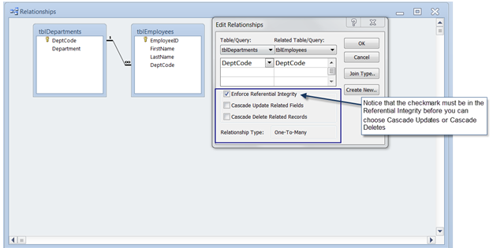

Slide 13
Cascade Update/delete
Once you make a change in the Primary Table and save that record, the changes will be made automatically in the Related Table.
If you click to select the Cascade Update Related Fields check box when you define a relationship, any time that you change the primary key of a record in the primary table, Microsoft Access automatically updates the primary key to the new value in all related records.
  For example, if you change a customer's ID in the "Customers" table, the CustomerID field in the "Orders" table is automatically updated for every one of that customer's orders so that the relationship is not broken. Access cascades updates without displaying any message.

Slide 14
ValidationRule
The ValidationRule property determines whether or not a field contains valid data. If the data is not valid, a trappable run-time error occurs.

Slide 15
Validation Rule
< > 0
> 1000 or is null
Like “A????”
>= # 1/1/96 # and < # 1/1/97 #
Entry must be a nonzero value.
Entry must be blank or greater than 1000
Entry must be 5 characters and begin with the letter “A”.
Entry must be a date 1996.
Note :When we use validation rule we can not store null
value in the field

Slide 16
Input mark property
It makes data entry easier and to control the values users can
Enter in a text box control.
Characters
  0
  9
  #
  L,?
  A,a
  &
  <
  >
Description
  Digit
  Digit or space
  Digit or space
  Letter (A to Z ,entry required)
  Letter or digit
  Any character or space
  Character convert to lowercase
  Character convert to uppercase

